Slide 1
Generation of Escher Arts with Dual Perception
Shih-Syun Lin¹, Charles C. Morace², Chao-Hung Lin²,
Li-Fong Hsu², Tong-Yee Lee²
¹Department of Computer Science and Engineering, National Taiwan Ocean University
²Department of Computer Science and Information Engineering, National Cheng Kung University

Slide 2
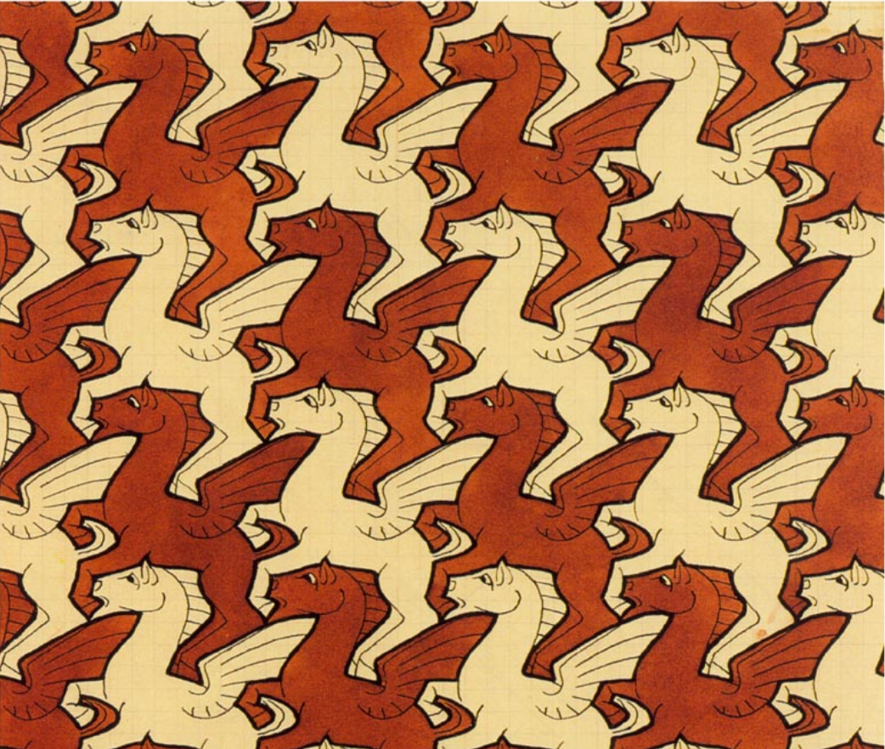
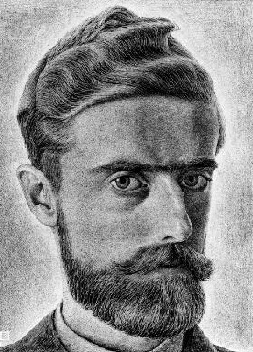
Introduction
M.C. Escher (1898-1972)
Master of tessellations
Ambiguity in visual perception
Variety of shape deformations
Notes:
This research was inspired by the artwork of M.C. Escher. Escher was a Dutch artist well-known for his use of tessellations. Tessellations (tiling) = collection shapes, covering the plane, no gaps, no overlapping areas. They have been used for centuries in art and architecture, but Escher used tessellations differently. Instead of just using abstract purely geometric shapes, Escher created tessellations using shapes from natural world such as different animals or famous mythological creatures like the Pegasus on the right. Escher's tessellations also have an interesting perceptual quality. The figure-ground assignment can switch instantaneously depending on which colored shape you focus your attention on. Escher created many tessellation artworks throughout his career and began to use a variety of shape deformations to emphasize this interesting perceptual quality.

Slide 3
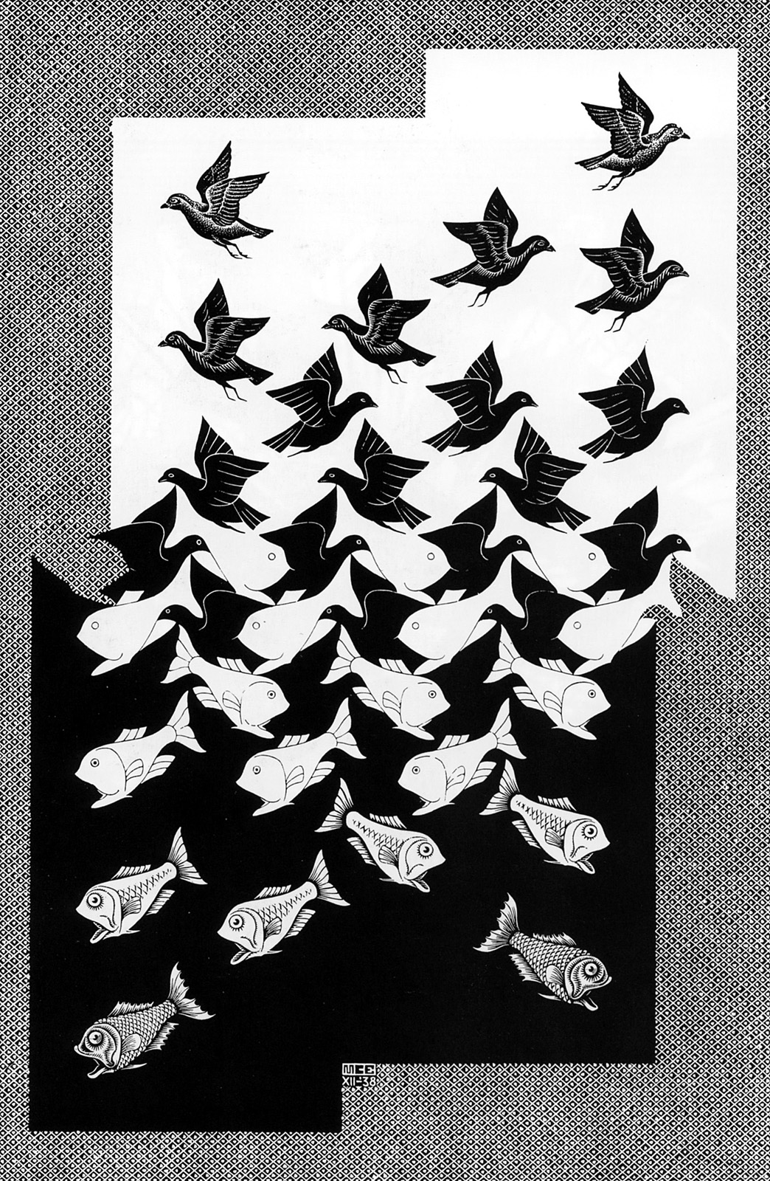
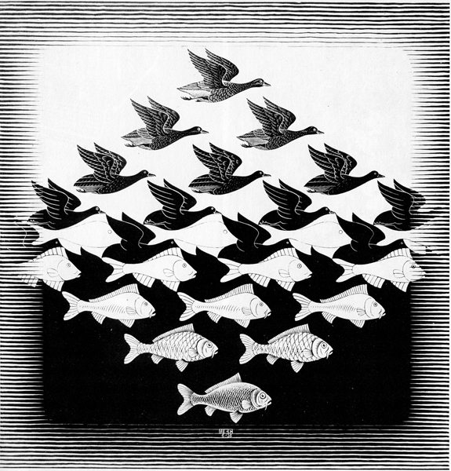
Introduction
Sky and water I and II
Notes:
Escher's use of shape deformation is apparent in his works Sky and water 1 and 2. Along the middle rows, the arrangement of fish and birds resemble a tessellation
The different shapes share a common boundary and seem to compete for the viewers attention. But as we move our visual attention up or down, one shape becomes prominently perceived as the figure while the other dissolves into the background. Escher enhanced this dual figure ground perception by progressively adding details to the interior of the bird and fish and deforming the shape boundaries.

Slide 4
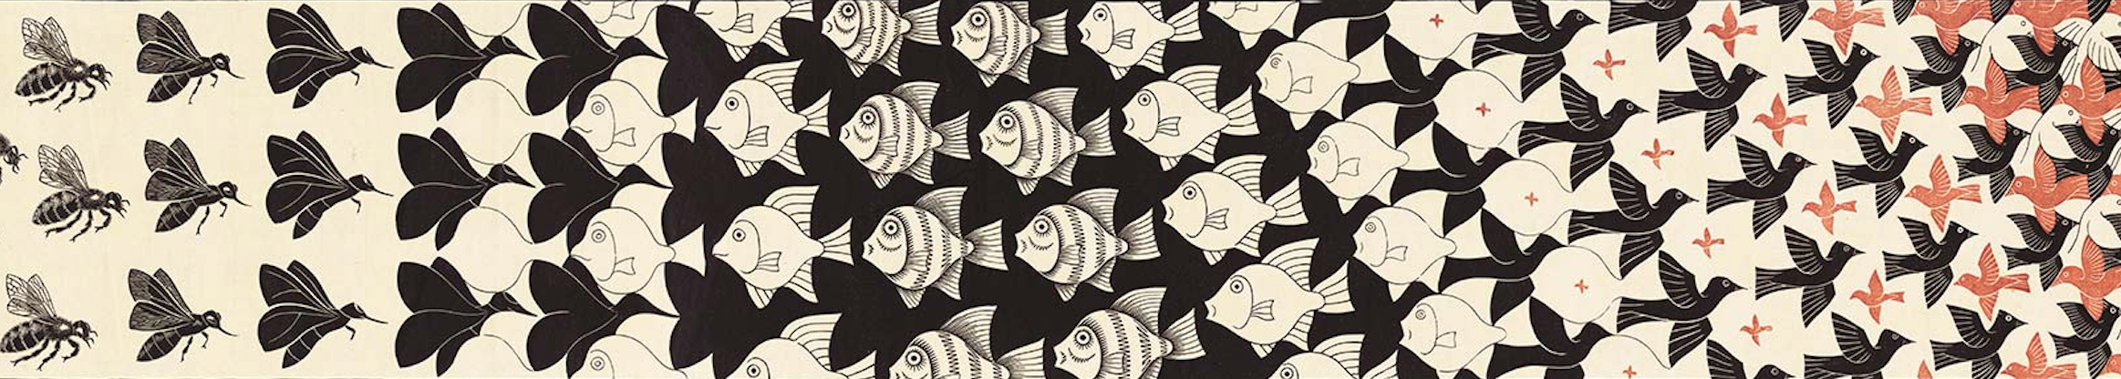
Introduction
Metamorphosis II
Notes:
Escher used a similar technique in his work Metamorphosis II. This is just a small section of the original work, but on the left side you can see how Escher progressively deforms and removes detail of bees until they eventually dissolves into the background, revealing the shape of fish. This process is repeated and applied to the fish as the black birds emerge from the background. Then Escher uses a different kind of deformation, increasing the scale of the red birds so that they eventually fill the background space and become the dominant figure.
In this research we propose a system that realizes these shape deformations found in Escher’s artwork. And with very limited user interaction, this system has the ability to produce a variety of results with dual figure-ground perception.

Slide 5
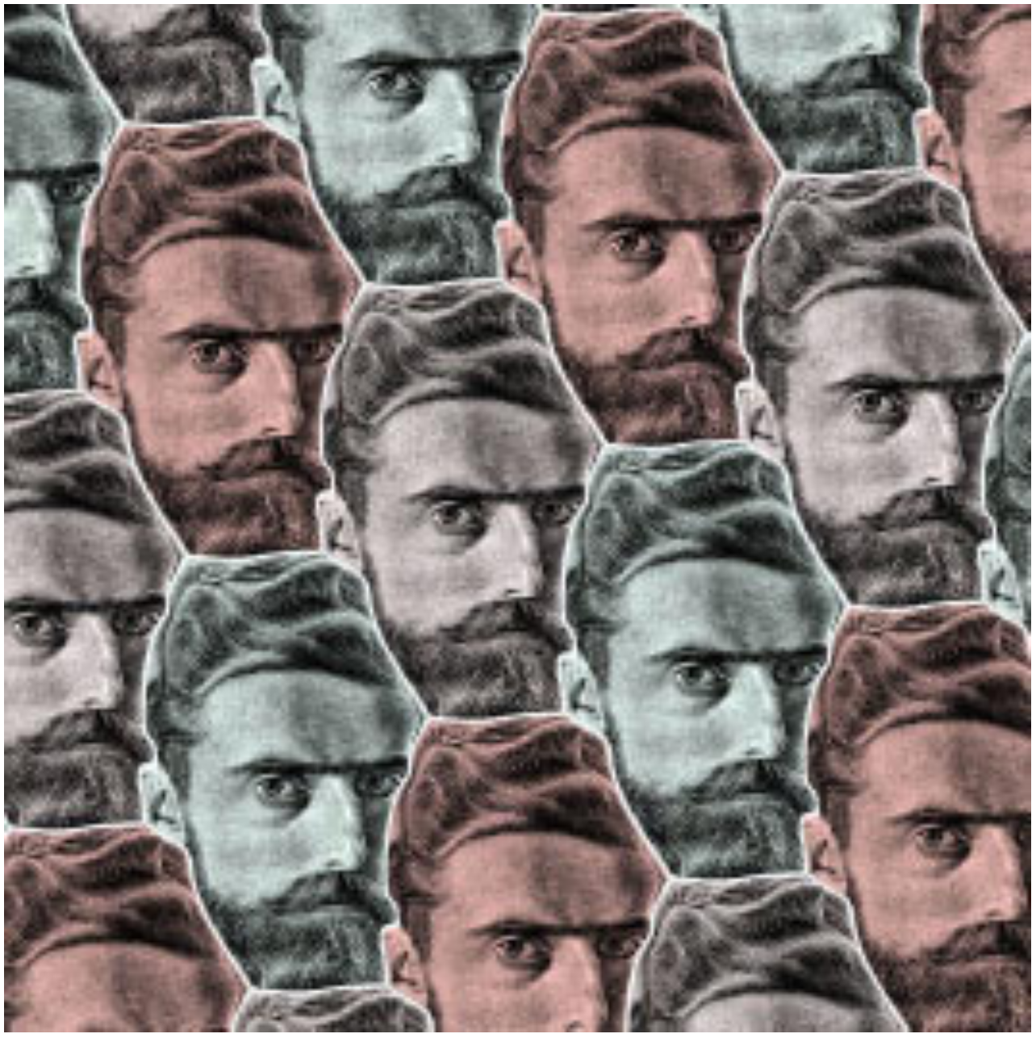
Related Work
Escher-like tessellations
Escherization [Kaplan 2000]
Dihedral esherization [Kaplan and Salesin 2004]
Maximum eigenvalue problem for escherization [Koizumi and Sugihara 2011]
[Kaplan 2000]
Notes:
Escherization: given a closed figure, find a new closed figure that is similar to the original and tiles the plane
Dihedral escherization proposes a method to generates a tilings with two different tile shapes.
Koizumi and Sugihara pose escherization as a maximum eigenvalue problem which can be solved more effeciently

Slide 6
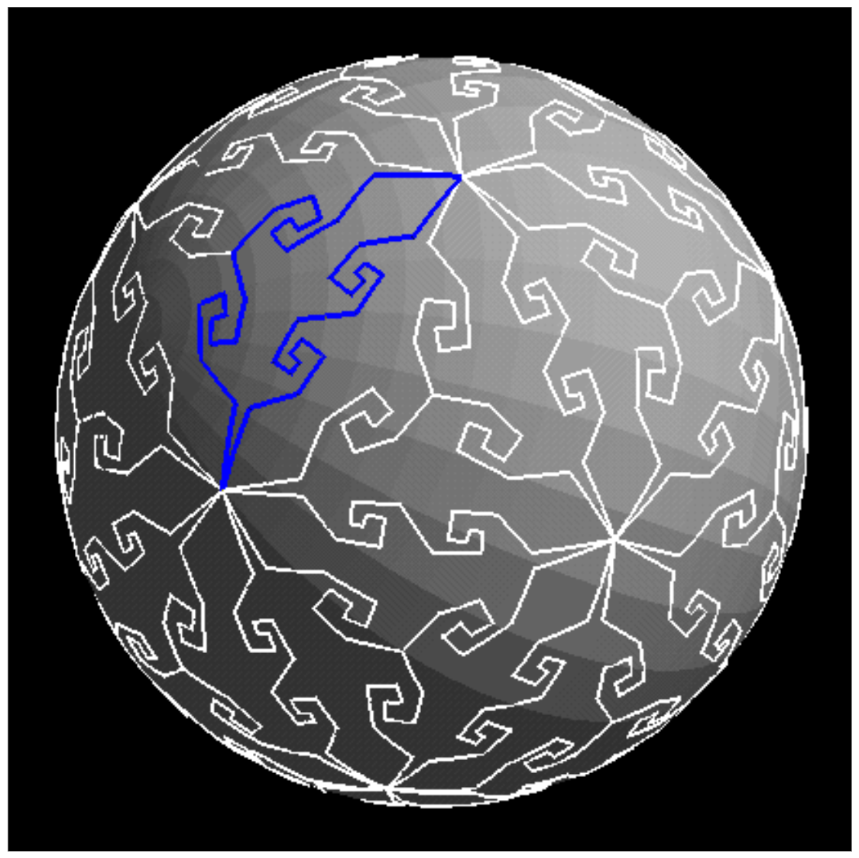
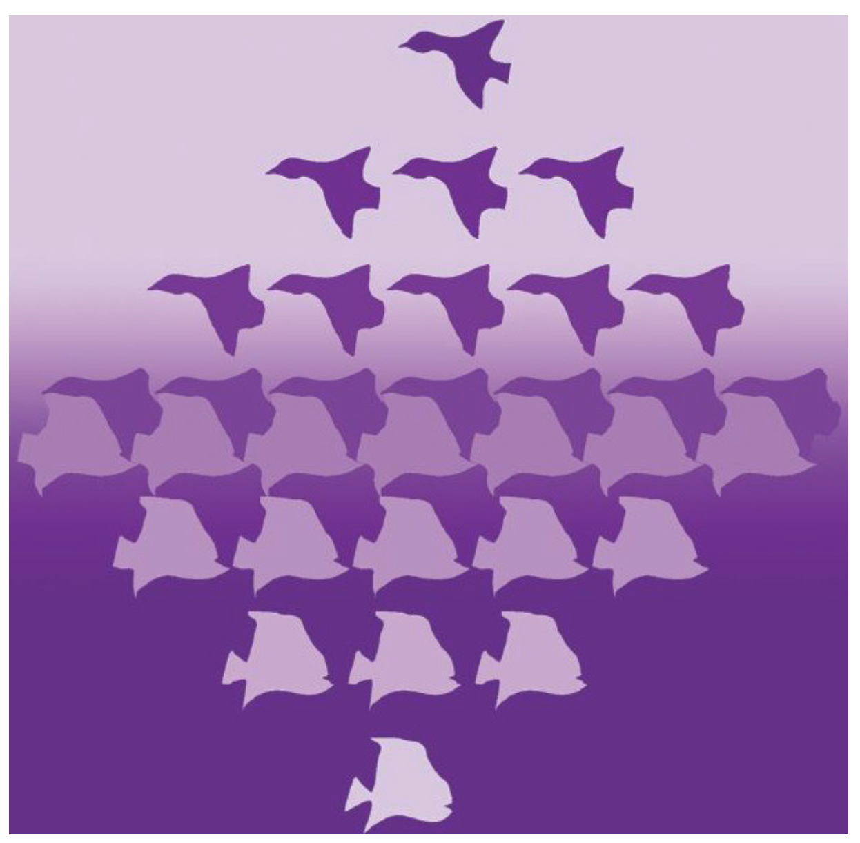
Related Work
Special Escher-like art
Escher sphere construction kit [Yen and Sequin 2001]
Computer-aided generation of Escher-like sky-and-water tiling patterns [Sugihara 2009]
[Yen and Sequin 2001]
[Sugihara 2009]
Notes:
Methods to generate other types of escher-like art such as Esher-like tesselations on the surface of a sphere and the generation of sky and water tiling patterns have also been proposed.

Slide 7
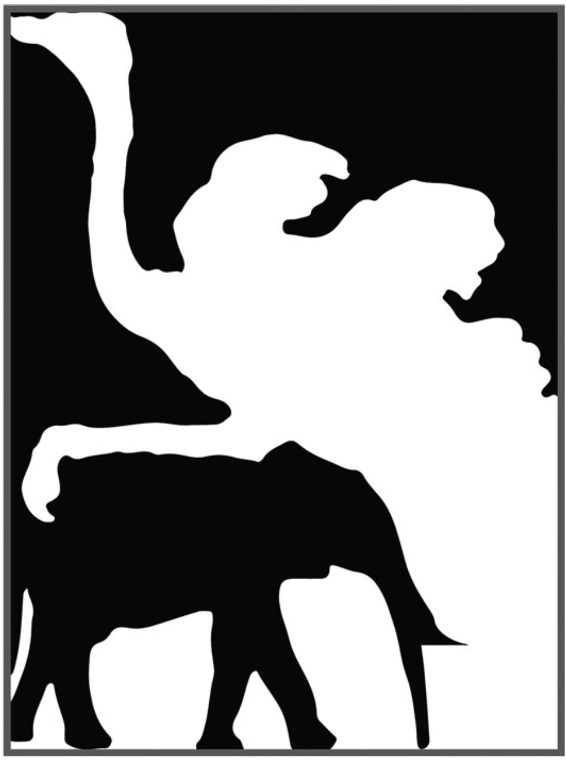
Related Work
Dual figure-ground perception
Inhibitory competition in figure-ground perception [Peterson and Salvagio 2008]
Lessons in duality and symmetry from M.C. Escher [Schattschneider 2008]
Generating ambiguous figure-ground images [Kuo et al. 2017]
[Kuo et al. 2017]
Notes:
Our work is also related to figure ground perception. Figure-ground perception has been well studied. In relation to Gestalt-psychology, Peterson and Salvagio study the effect of convexity in figure ground assignment, Schattscneider has studied the use of duality and symmetry in Escher’s Art and it's effect on figure-ground perception. And more recently, Guo and others proposed a method for generating ambiguous figure-ground images

Slide 8
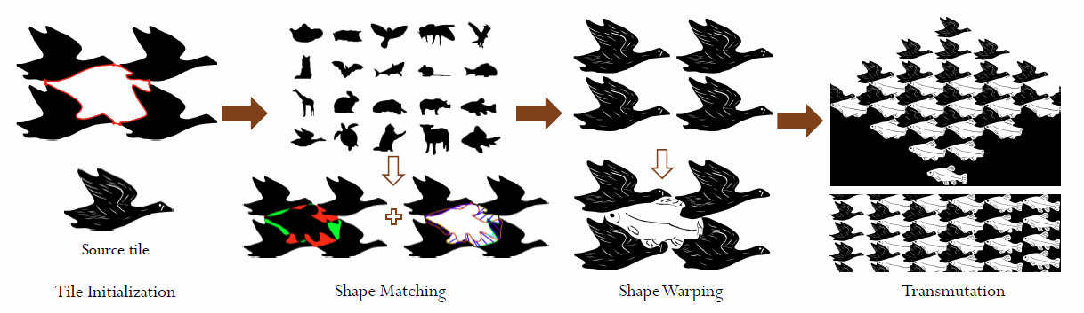
System Overview
Notes:
Here I will introduce the system overview of our proposed method.
Our system consists of three major steps, tile initialization, shape matching, and content-aware shape warping.
The input to our system is a user-defined source tiles and a tiling layout template which is based on a particular pattern used in Escher’s artwork
In tile initialization an initial contour is determined by the surrounding source tiles we call the virtual tile.
In the shape matching phase, the contour of the virtual tile is used to search a database for the best-matched shape based on curvature, contour correspondence, and overlapping area information.
Then in shape warping we propose a significance measure for the interior features of each tile to generate a smooth shape transformation that preserves important features as much as possible and progressively removes less important features in order to enhance the dual-figure-ground perception effect.
Now I will describe each step in more detail

Slide 9
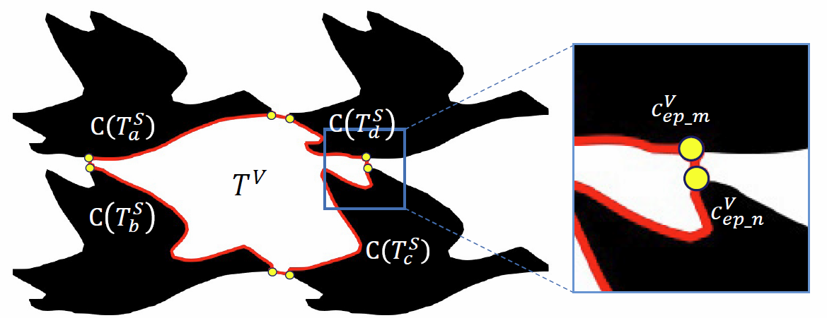

Methodology
Tile Initialization
Prefer large curvature and small distance
Notes:
The goal of tile initialization is to obtain a closed contour from the user-defined source tile arrangement.
We do this by finding corresponding boundary points between neighboring source tiles(shown in black).
These boundary points are computed by considering two terms, curvature and the distance between corresponding boundary points.
The boundary points are computed my minimizing the following objective function where E-curvature represents the inverse of the curvature at the boundary points and E-close represents the Euclidean distance, and the values are normalized to be in the range of 0 and 1. The boundary points are determined by minimizing this objective function

Slide 10
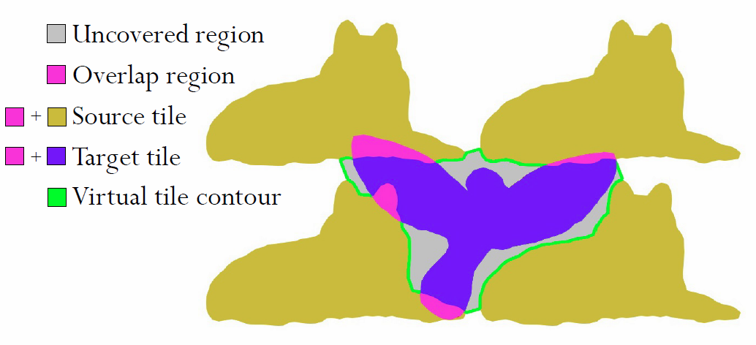
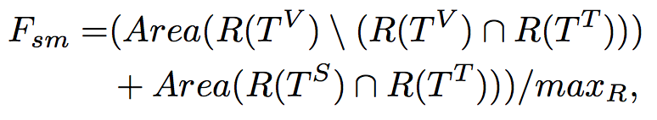
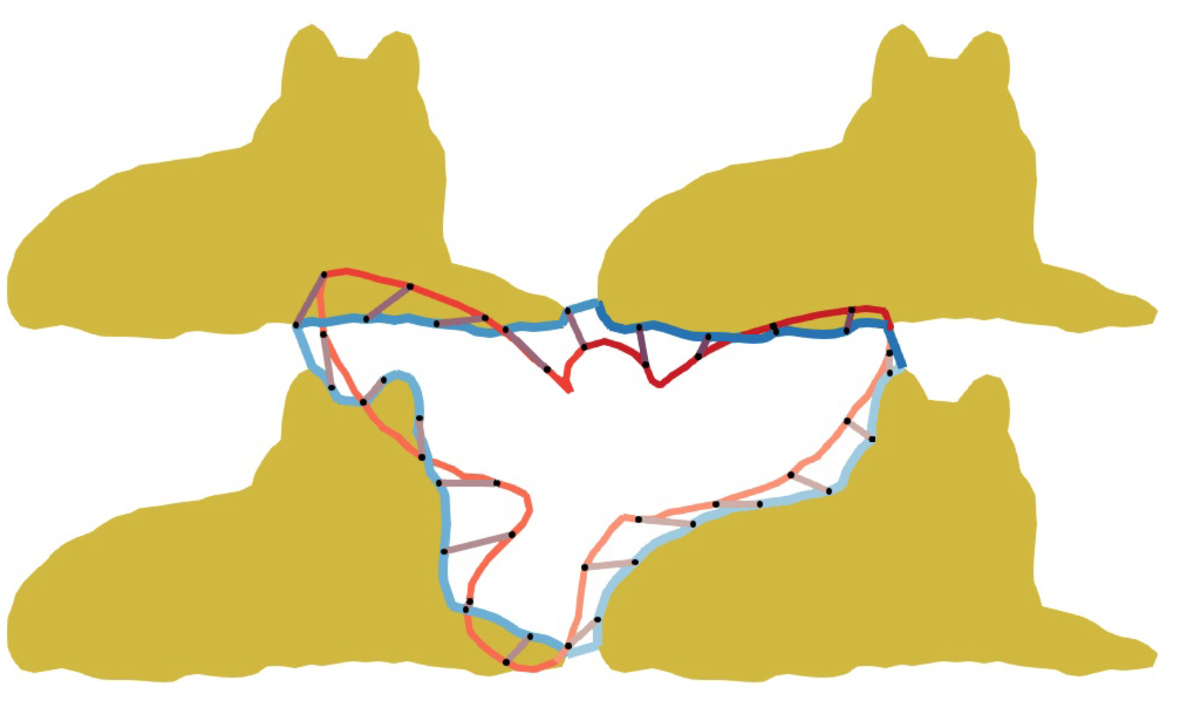
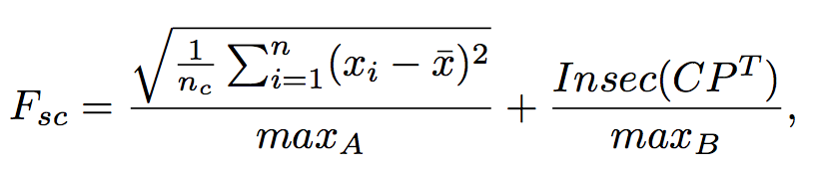
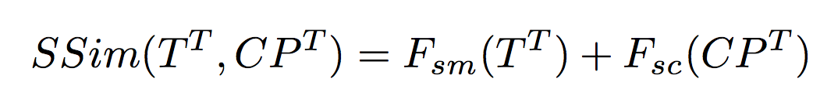
Methodology
Shape Matching (two-phase)
Curve matching [Cui et al. 2009]
Shape similarity
Overlapping areas
Correspondence consistency
Notes:
The shape matching is done in two phases. First we use the method for planar curve matching proposed by Cui. This curve matching is based on the integral of unsigned curvatures and gives us a contour correspondence between the source tiles and target tile as well as an optimal similarity transformation for the target tile, including scale, rotation, and translation. In the second phase, we consider overlapping areas and the contour correspondence to define a shape similarity metric. The shape similarity factor is the sum of the uncovered region (shown in grey) and the overlap region (shown in pink). The shape consistency factor considers the standard deviation of the length of each line segment connecting the corresponding boundary points and the number of intersections occurring in these line segments. Finally the shape similarity measure is the sum of these two factors. Notice that if the target tile exactly matches the virtual tile then the shape similarity measure is zero. In our system, the target tile with the smallest shape similarity measure can be chosen automatically or the user can select among the target tiles with the smallest shape similarity measures.

Slide 11
Methodology
Content-aware Shape Warping
Preprocessing
Feature significance measure
Delaunay triangulation
Triangle significance value
Objectives
Shape preservation
Control point
Smooth boundary

Slide 12
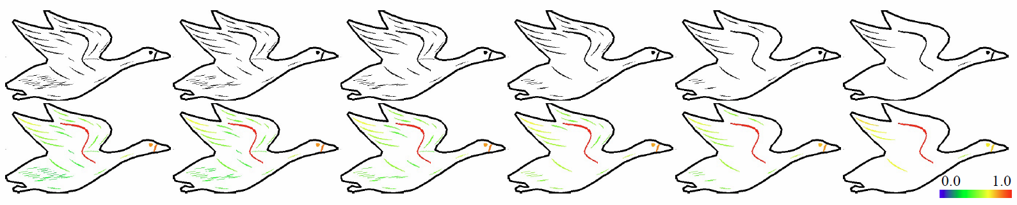
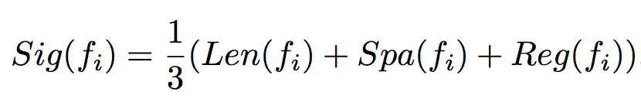
Methodology
Content-aware Shape Warping
Significance measurement
Length, sparsity, and regularity determine feature significance
Notes:
Longer feature lines are considered more important
Feature lines in sparse regions are considered more important
Feature lines with regular shapes such as circles are considered more important

Slide 13
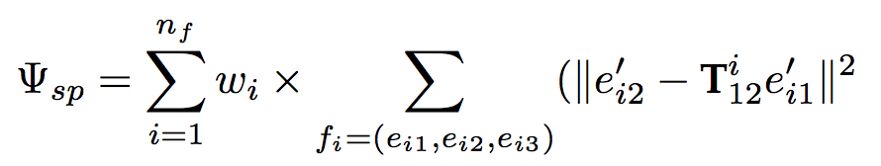
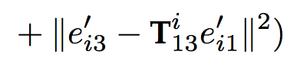
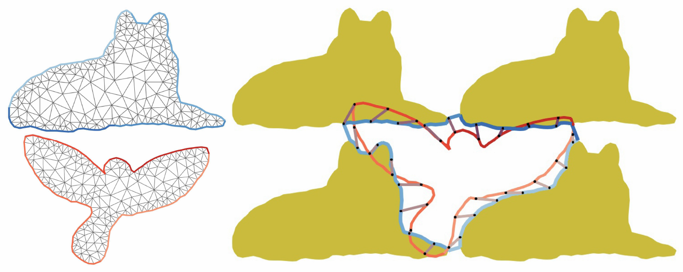
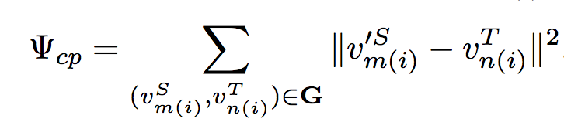
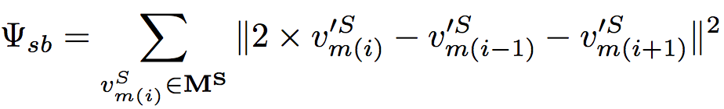
Methodology
Content-aware Shape Warping
Shape preservation constraint
Control point constraint
Smooth boundary constraint

Slide 14
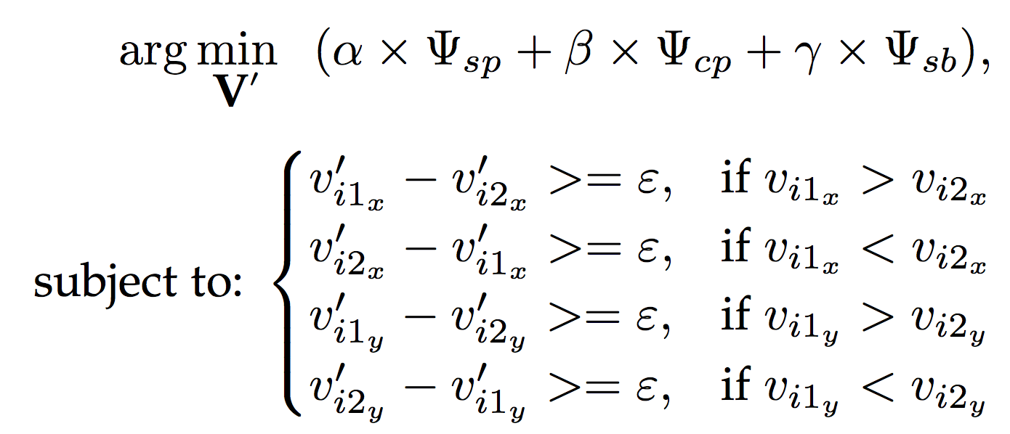
Methodology
Content-aware Shape Warping
Warping optimization

Slide 15
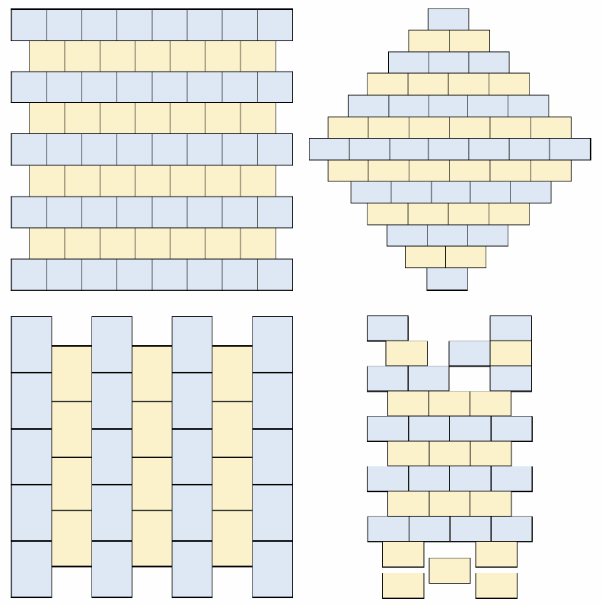
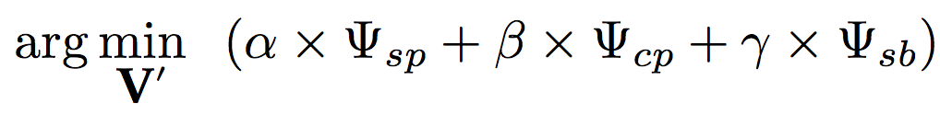
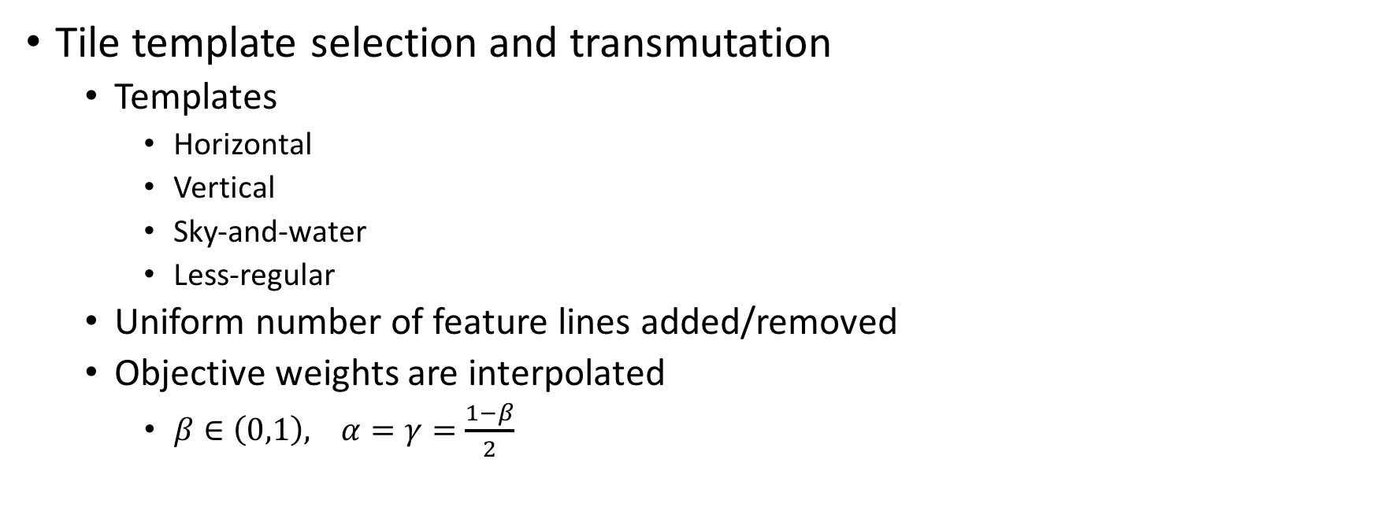
Methodology
Tile template selection and transmutation
Templates
Horizontal
Vertical
Sky-and-water
Less-regular
Uniform number of feature lines added/removed
Objective weights are interpolated
$β∈\left(0,1\right), α=γ=\frac{1−β}{2}$

Slide 16
Results

Slide 17
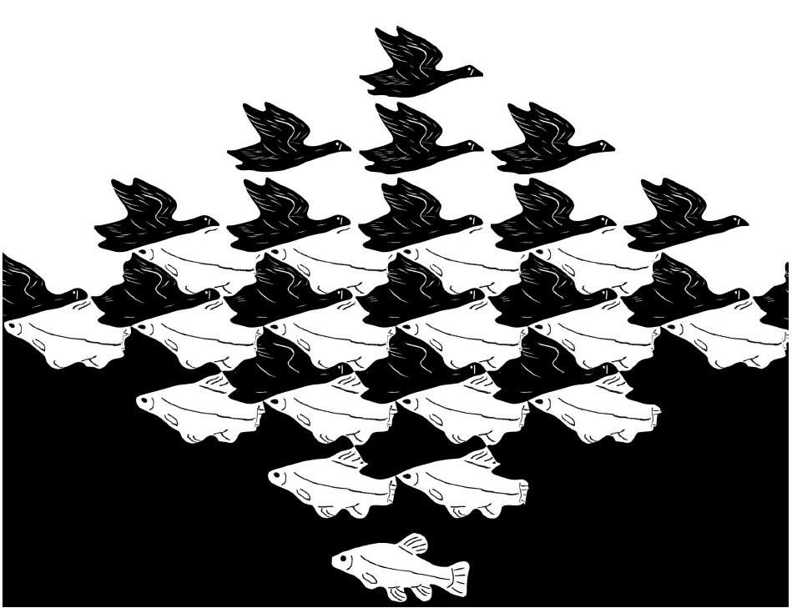
Results
Sky and Water I

Slide 18
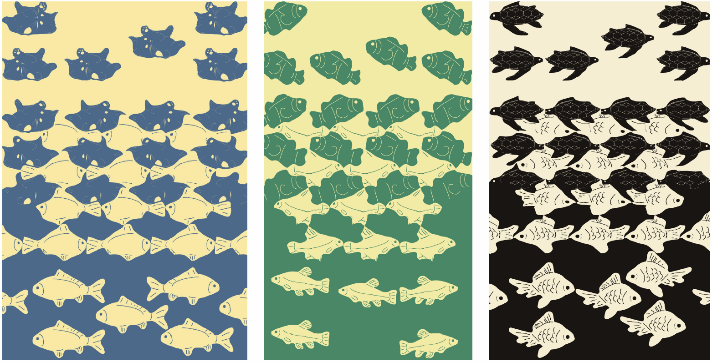
Results
Sky and Water II

Slide 19
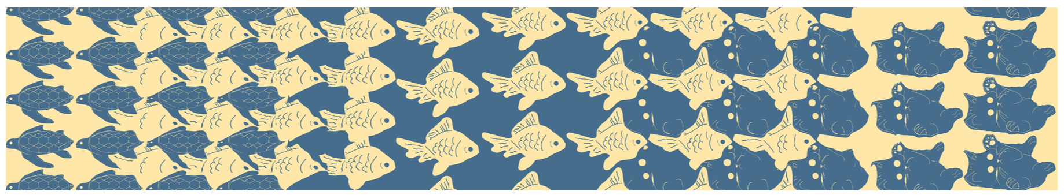
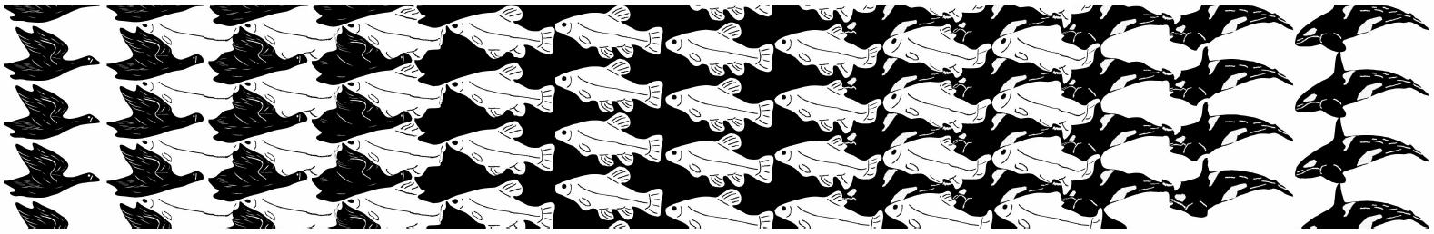
Results
Interpolation Deformation

Slide 20
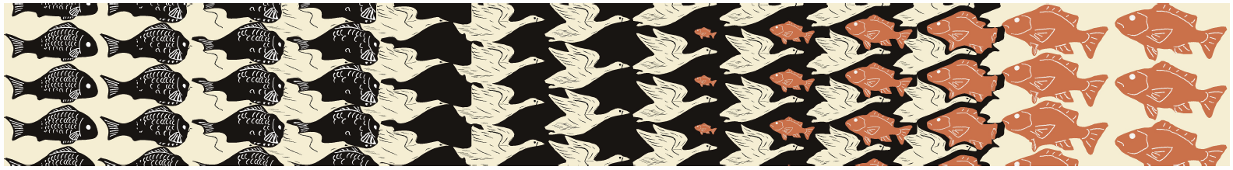
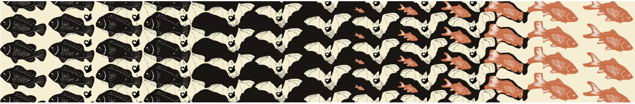
Results
Interpolation and Growth Deformation

Slide 21
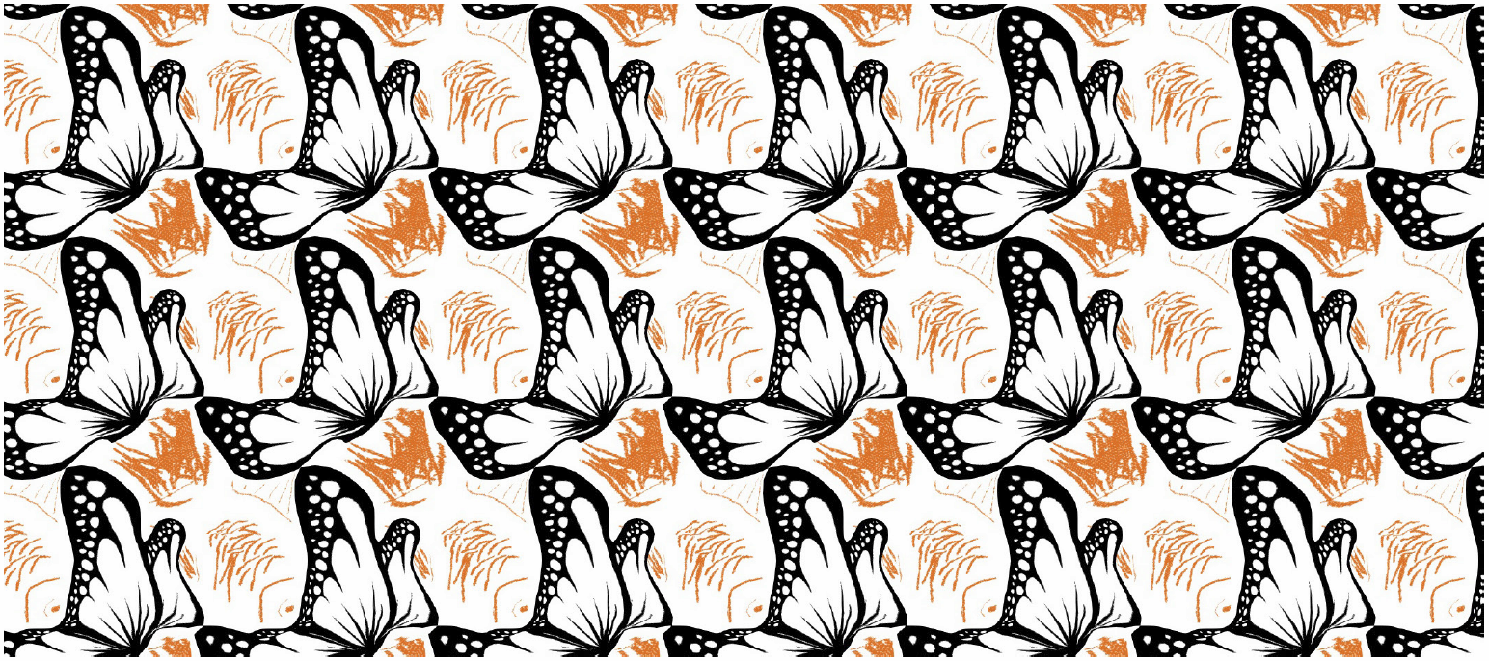
Results
Dihedral Tessellation

Slide 22
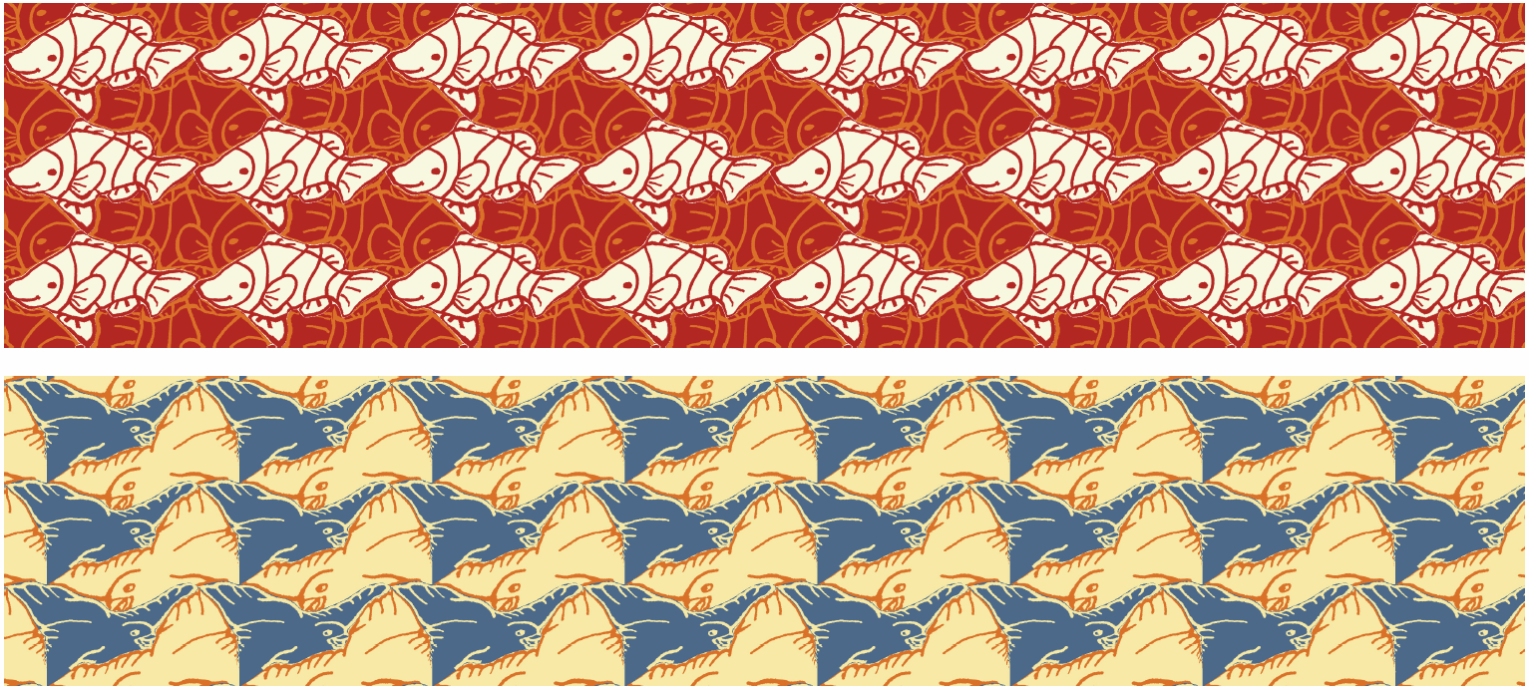
Results
Single Source Tile Tessellation

Slide 23
Results
Performance
Average computation times
Tiling initialization: 0.08 s.
Shape matching per tile: 0.41 s.
Feature line simplification: 0.23 s.
Shape transmutation: 4.34 s.

Slide 24

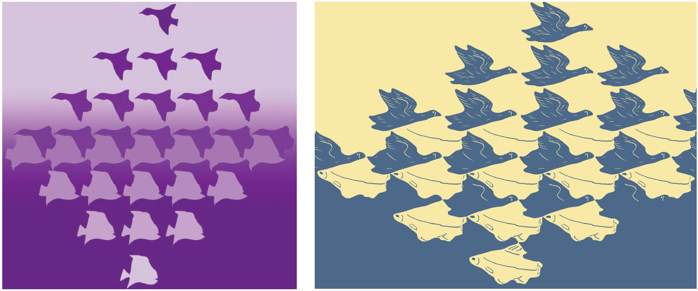
User Study
70 participants aged 20-52 years old
Results compared with those of [Sugihara 2009]

Slide 25
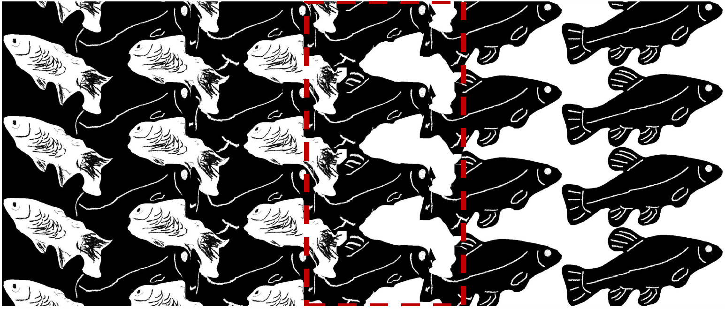
Limitations

Slide 26
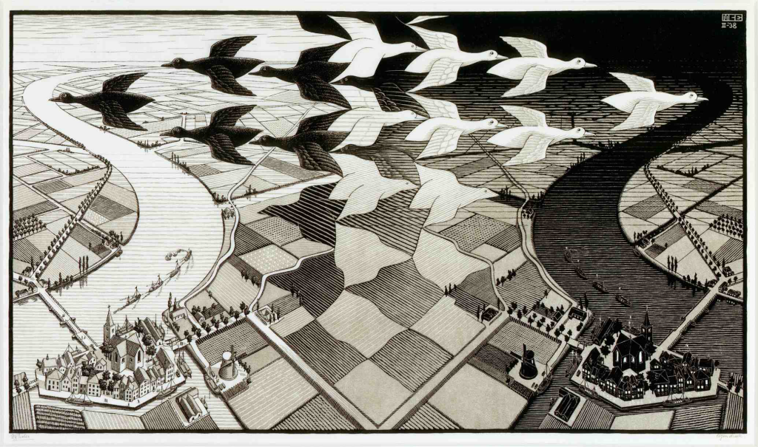
Future Work
“Realization” deformation

Slide 27
Conclusion
This study proposes several techniques, including tile initialization, shape matching, and context-aware warping to generate Escher arts with dual perception
A variety of shape deformations commonly found in Escher’s art are implemented and provided in our system
The conducted user-study shows that our results are better than those in [Sugihara 2009] in terms of aesthetics, smoothness, and dual figure-ground perception
Our system can be used as a tool for both serious and casual artists to efficiently create elegant Escher-like art

Slide 28
Thank You!
For supplemental results and demo video please see our webpage
http://graphics.csie.ncku.edu.tw/Escher/tvcg-escher_art.pdf
http://graphics.csie.ncku.edu.tw/Escher/Main_video.mp4
http://graphics.csie.ncku.edu.tw/Escher/More_results.mp4

